Slide 1
Слайд 1 с информацией о кадрах
Spoken Assessment
Kaluhin Artem, Erzhan Bugenov, Ilyas Utenov

Slide 2
Слайд 9 с информацией о кадрах
Main Targets
The main idea when creating this site was to simplify the purchase of tickets for buses, trains and planes, the data of which was taken from the database for further processing
- we get information about upcoming flights from the database
- after that you can choose one of the suggested cities that were received after processing the database
- after selecting all the required data, you are offered flight options suitable for you
- after that you are transferred to a page where you need to fill in the data on all passengers, as well as pay for tickets, the price of which is formed from the price in the database and the number of passengers you specified
Our program works in several stages.

Slide 3
Слайд 2 с информацией о кадрах
Working with data
Getting the information from the database
Getting the information from the user
Storing information about tickets in the database

Slide 4
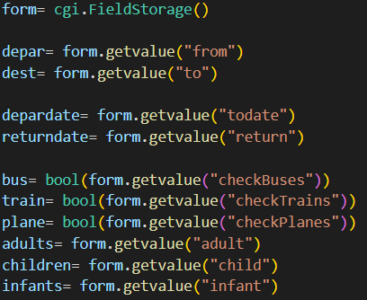
Слайд 9 с информацией о кадрах
Getting information from User

Slide 5
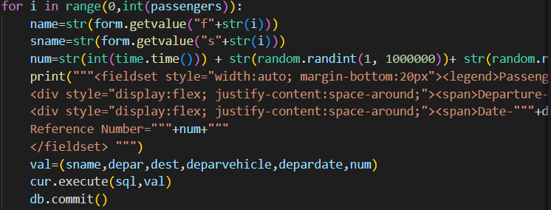
Слайд 9 с информацией о кадрах
Storing information to database

Slide 6
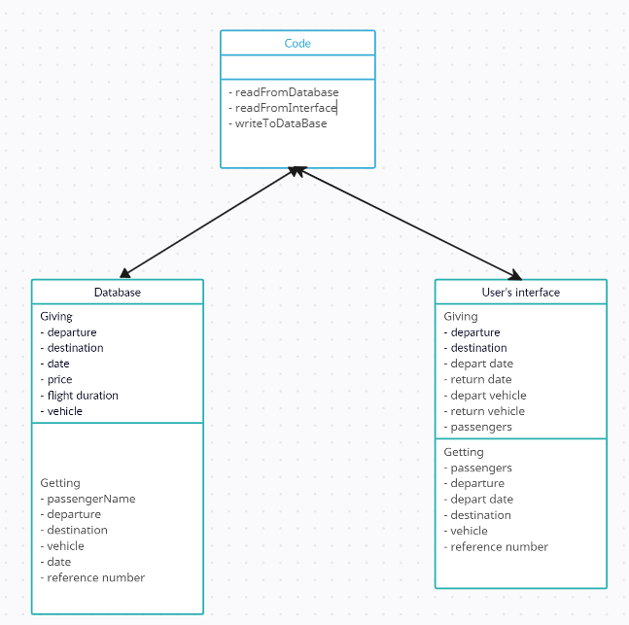
Слайд 9 с информацией о кадрах
UML diagram

Slide 7

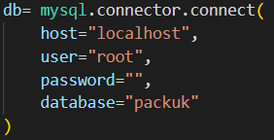
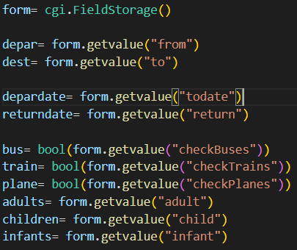


Слайд 3 с информацией о кадрах
mysql.connector
- to start working with databases we need to connect to them
- after that we write a query and parse it, getting an array of values ​​we need
- also, at the end you need to save the data that has appeared in the database
Python
Python CGI
At the time of writing this web site, Python was also used.
- to start working with Python CGI we need to specify the path of your python
We used standard tools like loops, if-statement, variables
- after it we need to get some values from user
But work with databases and web pages was also included
To work with databases, we used mysql.connecotor
To work with web services, we used Python CGI
- and last we send a request to write the following web pages

Slide 8
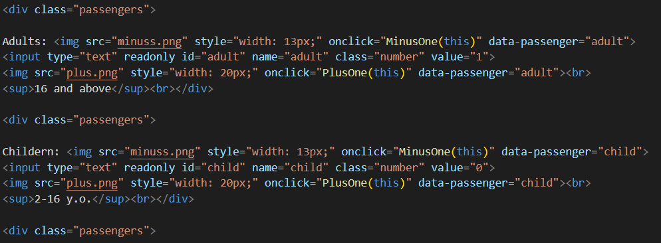
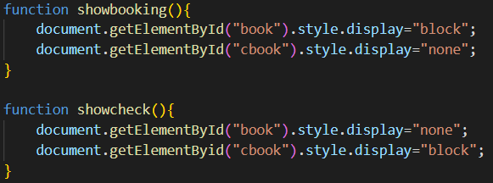
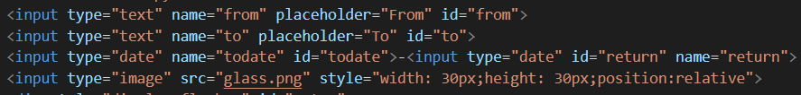
Слайд 3 с информацией о кадрах
HTML
To summarize, when using the HTML language, we used tags such as:
-fieldset(used to group multiple elements)
-form(used to establish communication between server and user)
-input(receives data from the user)
-img(works with images)
-button(creates a new clickable button)
When writing websites, HTML is the main component, which in our case was also integrated into Python.
During development, we split the user page into separate blocks, for this we used "div"
Also, to make the pages responsive to the user’s actions we used script tags and functions.
Due to the fact that we needed to receive user data, we also had to work with «forms and inputs"

Slide 9
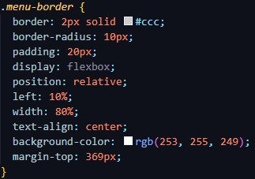
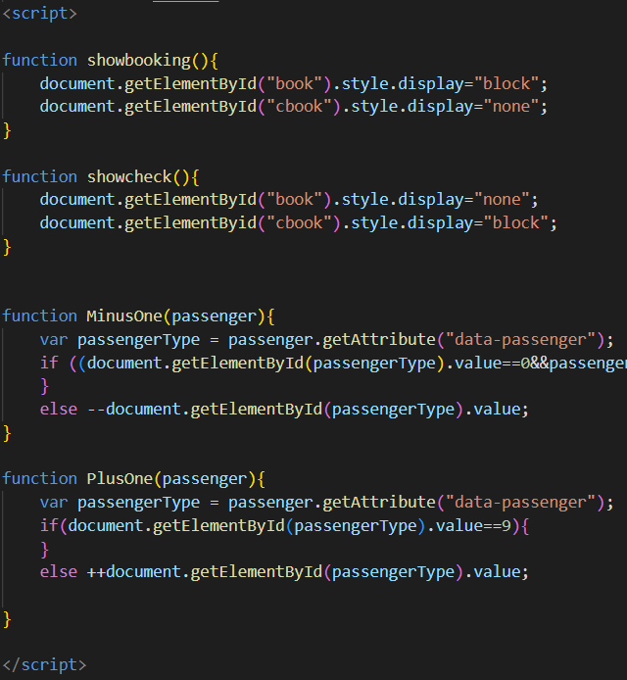
Слайд 3 с информацией о кадрах
CSS
JavaScript
In the course of writing the program, CSS was also used.
We also managed to work with JavaScript. This language was used when writing functions in .html files
When using it, several classes were written (for example, "menu-border", "banner", "top")
Inline styles were also used to introduce small visual changes

Slide 10
Слайд 9 с информацией о кадрах
Summary
- languages ​​such as HTML, CSS, JavaScript, Python were used to complete this task
-- contact was established between the user and the system
- the principle of the program was shown
- the main methods that were used were shown
- low-level implementation was shown using UML diagrams

Slide 11
Слайд 10 с информацией о кадрах
Thank you, for your attention

